Slide 1
Simulation 3D Fireworks Based on Particles System
Course: Computer Graphics
Professor: Dr. Ian Stavness
Student: Arman Heydari
Zhao, H., Fan, R., Wang, C. C. L., Jin, X., & Meng, Y. (2009). Fireworks controller.

Slide 2
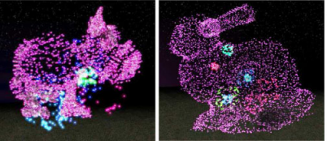
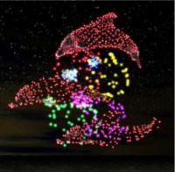
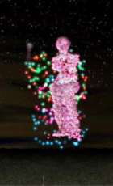
Goal: construct a shape with particles after a fire explosion

Slide 3
Instance Mesh Algorithm
Each particle is a little quad, it can be a sphere or something.
call glDrawArrays once for each particle → very bad idea, all multiprocessors use to just draw a single quad.
base mesh (in our case, a simple quad of 2 triangles), but many instances of this quad (10000).
buffers: for the vertices of the mesh, particles’ centers, particles’ colors.
use glDrawArrraysInstanced / glDrawElementsInstanced, which is equivalent to calling glDrawArrays N times. But works parallel for buffers.

Slide 4

Explosion
Random direction for each axis.
Random value for initialize velocity, shouldn’t be so small.
(Tutorial not Paper)

Slide 5
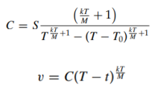
Physics Formulas after the explosion
M: initial mass of a particle, g: gravity acceleration, T: lifetime of the particle, T0: time it takes to reach the cluster, t: time spend after explosion, k: air friction coefficient, S: distance of the point at t=0 with the cluster
X,Z axis: (different S on each, but same formula)

Slide 6
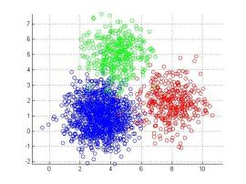
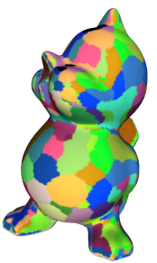
Sampling
Clustering: kmeans, iterative method for finding center of point groups.
Implemented in the application based on input mesh vertices.
Hyperparameters: number of clusters, iteration

Slide 7


Physics Formulas after the explosion
M: initial mass of a particle, g: gravity acceleration, T: lifetime of the particle, T0: time it takes to reach the cluster, t: time spend after explosion, k: air friction coefficient, S: distance of the point at t=0 with the cluster
Y axis (k issue in the paper, so ignored in implementation):

Slide 8
References
Zhao, H., Fan, R., Wang, C. C. L., Jin, X., & Meng, Y. (2009). Fireworks controller. Computer Animation and Virtual Worlds, 20, 185-194. https://doi.org/10.1002/cav.287
https://www.opengl-tutorial.org/intermediate-tutorials/billboards-particles/particles-instancing/
Hall, J. D., & Hart, J. C. (2004). GPU Acceleration of Iterative Clustering. University of Illinois at Urbana-Champaign.
https://www.istockphoto.com/photos/large-firework-explosion
https://prateekvjoshi.com/2013/06/06/what-is-k-means-clustering/

Slide 9
Result Videos attached. Thanks for listening! Any questions?

